Slide 1

Spotify Clone
VISHU SHARMA
21MCA3173
DISCOVER . LEARN . EMPOWER

Slide 2
What is a spotify clone ?
A Spotify clone app is a music streaming app which provide a free plateform to listenmusic without downloading it.
•The software is user-friendly from login to listening music.With the various features, users can enjoy listening to their favourite songs with ease..

Slide 3
History
Spotify
Developed in the 2006
Founded by DanielEk and martin lorentzon
Headquartor- Stockholm, Sweden

Slide 4
Used Technology
The Complete project is made in python language. The used Libraries are,
HTML5 – HTML (HyperText Markup Language) is the code that is used to structure a web page and its content. For example, content could be structured within a set of paragraphs, a list of bulleted points, or using images and data tables
CSS – CSS is the language for describing the presentation of Web pages, including colors, layout, and fonts. It allows one to adapt the presentation to different types of devices, such as large screens, small screens, or printers
JAVASCRIPT – avascript is used by programmers across the world to create dynamic and interactive web content like applications and browsers. JavaScript is so popular that it's the most used programming language in the world, used as a client-side programming language by 97.0% of all websites.
The IDE which is used for the project is VS-Code

Slide 5
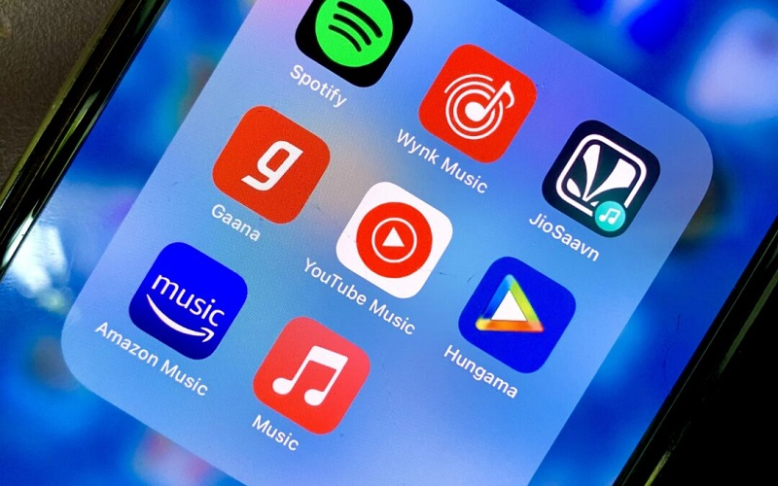
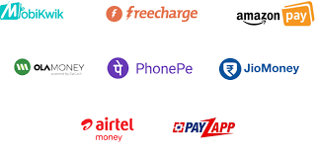
Need of the project
Some music player only avalible in online .so spotify cloneprovide the offline plateform for users . Users will use the offline option to stream the album and listen without usingthe internet
It is a freemium app also, some basic features are withadversting and limited control

Slide 6
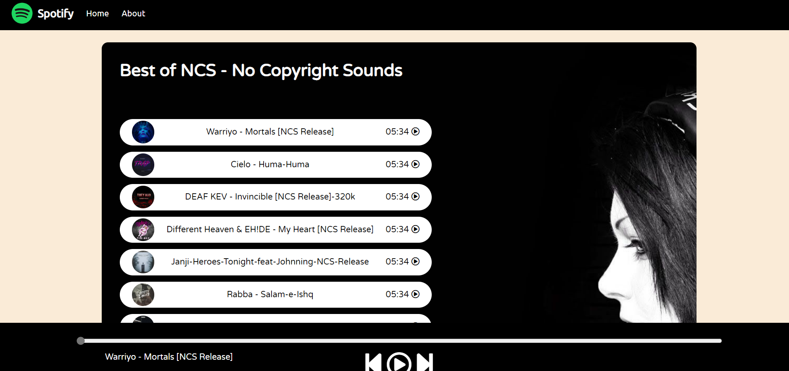
Objective-Spotify clone is working on offline mode

Slide 7
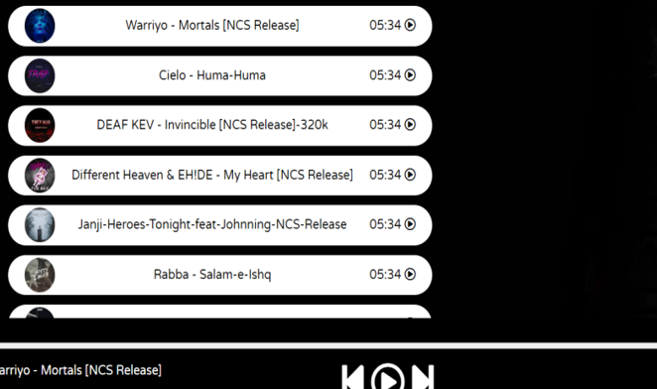
Working of the System
Songs List : We have List of songs in array and we will provide the file path of songs
1) Handle Play Pause Click
When we click on play button it will play a song with the help of play function similarly we have pause function to stop
2) Progessbar
we have made function on progressbar to increase or decrease.
3) timeupdate
we have made a timeupdate function to change the time as songs continue
View Partition Output

Slide 8
Future Scope
About to add best and new recommendations using Spotify API's.
Fetching and showing best songs and on loop songs directly on home screen.
Planning to make it production level so user can get best out of Spotify on just single scree.
GitHub Link
https://github.com/vishu5683/spotify-clone.git

Slide 9

THANK YOU

